Slide 1


Zomato Restaurants Analysis
Farseen Ahammed
23/10/2024

Slide 2
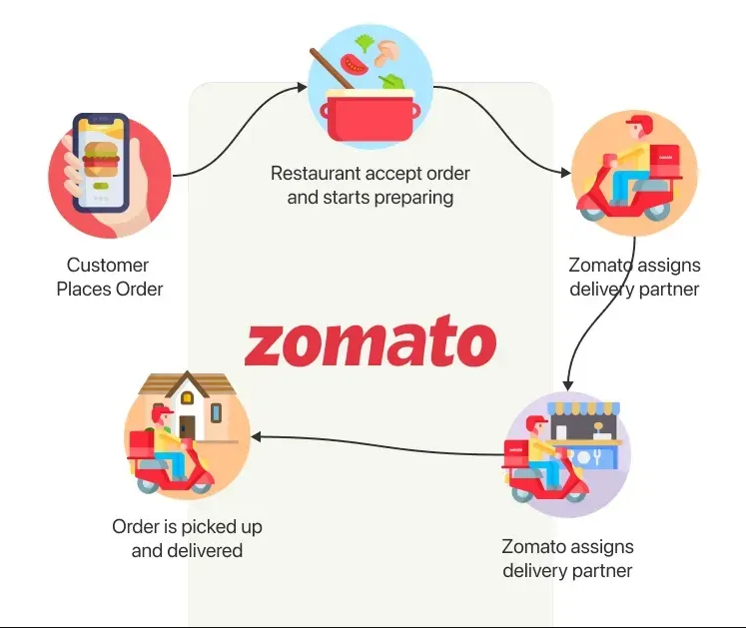
Introduction
Started In- July 2008, Delhi NCR.
Founded By: Deepinder Goyal, Pankaj Chaddah
Initially named- “FoodieBay”
In November 2010 it was renamed as “Zomato”
Parent Company – Info edge
Category – Mobile Application Based
Sector – Food & Restaurant guide
Tagline – Discover great places to eat around you
USP – Content is what sets Zomato apart – The restaurant & nightlife guide the menus, pictures and map locations
Segment – Young population, working professionals looking for information of restaurants
Target Group – All Smartphone Users
Positioning – Zomato provides the “guide” or the “discovery” experience of restaurants & food guide

Slide 3
Problem Statement
You are hired as a consultant data analyst by Zomato where the team is looking for expansion and opening more restaurants. Your task is to develop strategies/suggestions for opening newer restaurants.

Slide 4
Data Overview
Content: The dataset used for this analysis is sourced from Zomato, a leading restaurant discovery and food delivery platform. The dataset includes comprehensive information about restaurants from various countries, which is used to analyze market trends, restaurant distribution, and competitive landscapes.
Key Variables:
Restaurant ID: Unique identifier for each restaurant.
Restaurant Name: The name of the restaurant.
CountryCode: Country code of the location where the restaurant is situated.
City: The city where the restaurant is located.
Address: The specific address of the restaurant.
Locality: The locality or neighborhood where the restaurant is situated.
Locality Verbose: Detailed information about the locality.
Longitude: The geographical longitude coordinate of the restaurant.
Latitude: The geographical latitude coordinate of the restaurant.
Cuisines: The type of cuisine offered by the restaurant.
Currency: The currency used for transactions in the restaurant.
Has_Table_booking: Indicates whether the restaurant has a table booking option (Yes/No).
Has_Online_delivery: Indicates whether the restaurant offers online delivery (Yes/No).
Is_delivering_now: Indicates whether the restaurant is currently delivering (Yes/No).
Switch_to_order_menu: Indicates whether users can switch to the order menu (Yes/No).
Price_range: A numeric value indicating the price range category of the restaurant.
Votes: The number of votes or ratings/(feedback) received by the restaurant.
Average_Cost_for_two: The average cost for two people dining at the restaurant.
Rating: The overall rating of the restaurant is based on user reviews.
Datekey_opening: The date when the restaurant was opened.

Slide 5


METHODOLOGY
Data cleaning: Removed null and empty values which could hamper our analysis, such as in some places “cuisines” cell was empty and average_cost_for_two was 0 both are data entry/collection errors.
Data preparation: Used VLOOKUP() to place create a new column “country” alongside “country_codes’’ in Raw sheet. Also, created a new column “Average_Cost_with_currency” with string functions like MID() and FIND() to get average_cost with the native currency abbreviation for better representation.
Conversion: Converted average_cost_for_two in INR for sake of simplicity and readability.
Data aggregation: Used PIVOT Tables to summarize data in a constructive way to gain insights on various key metrics and patterns across countries
Regional Segmentation: Divided restaurants per country to gain insight on local market trends and further make decision on entering said markets.
Visualizasion: Created clear, dynamic and striking visualizations to help understand the data and market situations better across various segments of time.

Slide 6
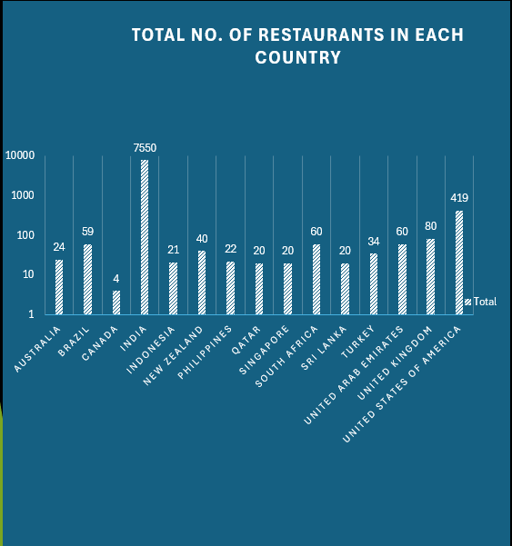
ESSENTIAL DETAILS FROM FILTERED DATA
There are a total of 8,433 restaurants in our dataset.
India has the most restaurants with around 91% or 7,550 restaurants.
Most of the data contains restaurants with ratings between 2.5 to 5.
There are 2,955 restaurants with rating between 1-3 stars, 4,369 restaurants with rating of 3-4 stars and 1,109 is the number of restaurants in the high rating range 4+ stars
India seems to be the country with the highest number of restaurants, amounting to 7,550 out of 8,433 restaurants we have in our cleaned dataset. This comes to about 91% of restaurants in our dataset. Followed by, USA and UK at 419 and 80 respectively.
Canada has the least number of restaurant after Qatar and Singapore with 4, 20 and 20 respectively. This indicates that there is a huge market share there for the taking in countries with less number of restaurants.

Slide 7
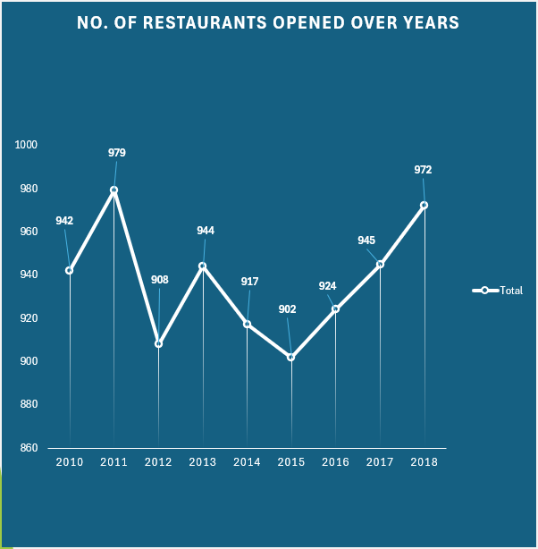
Trends in Restaurant Openings: A Decline, Recovery, and Future Outlook
We can see that new restaurant openings peeked in the year 2011 with 979 restaurants opened in a single year.
We can see after 2011 new restaurant opening took a huge plunge with just 908 new restaurants.
2013 was a little better with 944 new restaurants opened. Both 2014 and 2015 saw decline in the trend.
2015 was by far the worst year with only 902 restaurants opened.
After, 2015 we are seeing a steady growth in new restaurant opening and judging by the past trend it is expected to continue, we should focus on getting on this trend while its positive and open new restaurants.

Slide 8
Country | Count of RestaurantID
Australia | 24
Brazil | 59
Canada | 4
India | 7550
Indonesia | 21
New Zealand | 40
Philippines | 22
Qatar | 20
Singapore | 20
South Africa | 60
Sri Lanka | 20
Turkey | 34
United Arab Emirates | 60
United Kingdom | 80
United States of America | 419
Suggested Countries
We can see that Canada, Qatar, Singapore and Sri Lanka are the top 4 countries with the least number of restaurants.
Less number of restaurants mean that the market is not saturated yet.
Less saturation means less competition.
Therefore, the suggestion is to focus on entering these countries.
We can further narrow our approach to focus on specific cities first.

Slide 9
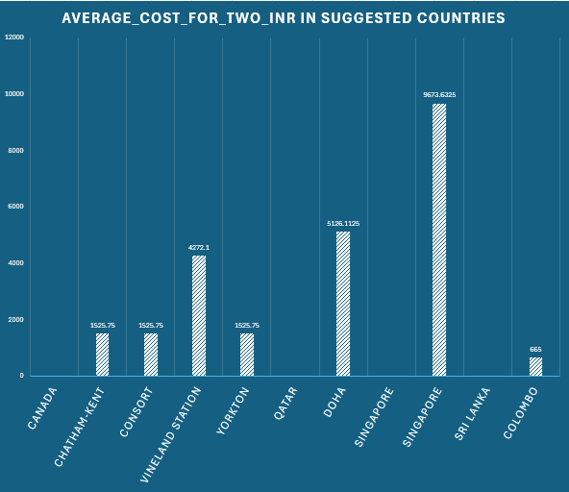
Evaluating Key Global Markets Based on Average Cost and Market Saturation
The second metric we are going to use is average cost for two, places where this cost is high, we can have higher profits, we can use this metric to further narrow down our focus to certain cities.
In Canada, we can see that Vineland Station is the best location because it fits our game plan perfectly.
Doha apart from being a major population center for Qatar, also houses a very lucrative food market and have low saturation.
Singapore is a city-state so geographically and financially it makes no sense to not open new restaurants there, as saturation is low and food expenditure is the highest in our suggestions list.
Colombo, has the least food expenditure of all suggested countries, but what it does have is large population and relatively less number of restaurants serving them.

Slide 10
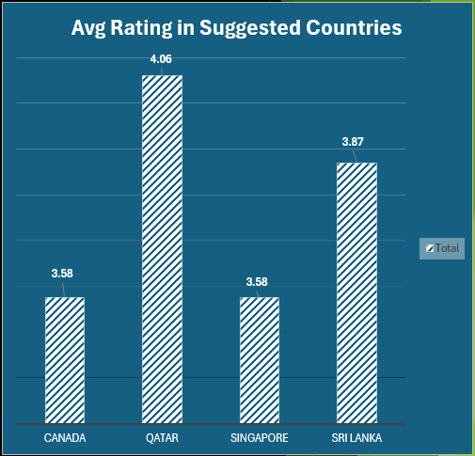
Analyzing Average Customer Ratings to Maximize Restaurant Success
To maximize success of new restaurants we can further study the average ratings in the target countries.
We can see from the above chart that the average rating varies from 3.58 to 4.06 on a scale of 5.0.
Qatar has the highest average rating of 4.06 followed by Sri Lanka with 3.87.
Singapore and Canada have the lowest rating out of all the suggested countries with an average rating of 3.58.

Slide 11
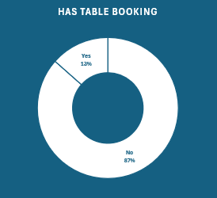
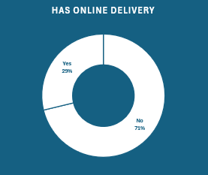
Assessing the Impact of Online Delivery and Table Booking on Customer Ratings
Opportunity for Differentiation: None of the suggested countries offer online delivery, and only one provides table booking, presenting a gap we can fill.
Proven Success in One Location: The only restaurant with table booking (in Doha) has a high rating of 4.7, showing potential for success with these services.
Unique Selling Point: Introducing online delivery and table booking in our new restaurants will differentiate us and attract more customers in underserved markets.

Slide 12
Strategic Restaurant Positioning: Targeting Mid-Range Ratings in Key Markets
Based on the average ratings, our focus should be on opening a semi-upscale restaurant and targeting a mid-range rating between 3.1 and 3.5 in cities like Doha and Colombo.
In Singapore, the competition within this rating range is intense, making it challenging at first.
However, given the high average food spending in Singapore, we can invest more and aim for a higher rating range of 3.5 to 4.0.
Notably, Vineland Station has zero competition in the mid-range rating bracket. In summary, our new target markets present minimal competition concerning ratings.

Slide 13
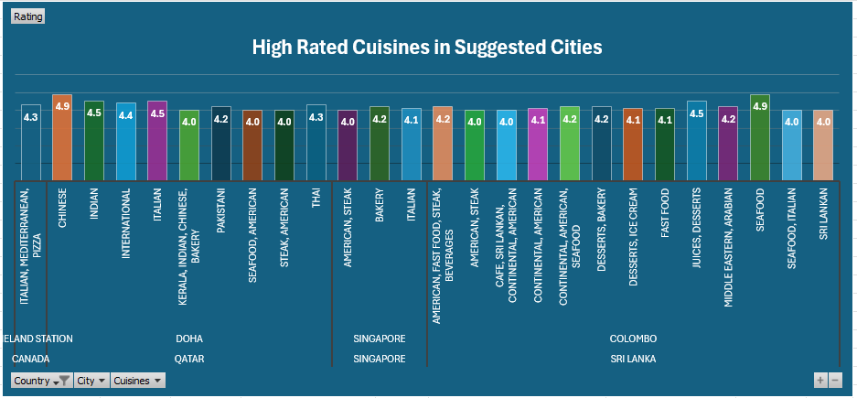
Cuisine Preferences Across Markets: Tailoring Menus for Regional Success
Cuisine is a key factor in restaurant success.
Singapore: Bakery, Italian, and American cuisines are the most popular and highly rated.
Doha: Top-rated restaurants mainly serve Chinese, Italian, Thai, and Indian cuisines
Colombo: Locals prefer Seafood, Juices, Desserts, and American cuisine.
Vineland Station: Italian and Mediterranean cuisines are quite popular.
Conclusion: Each region has its own preferred cuisine, and we should aim to cater to these tastes accordingly.

Slide 14
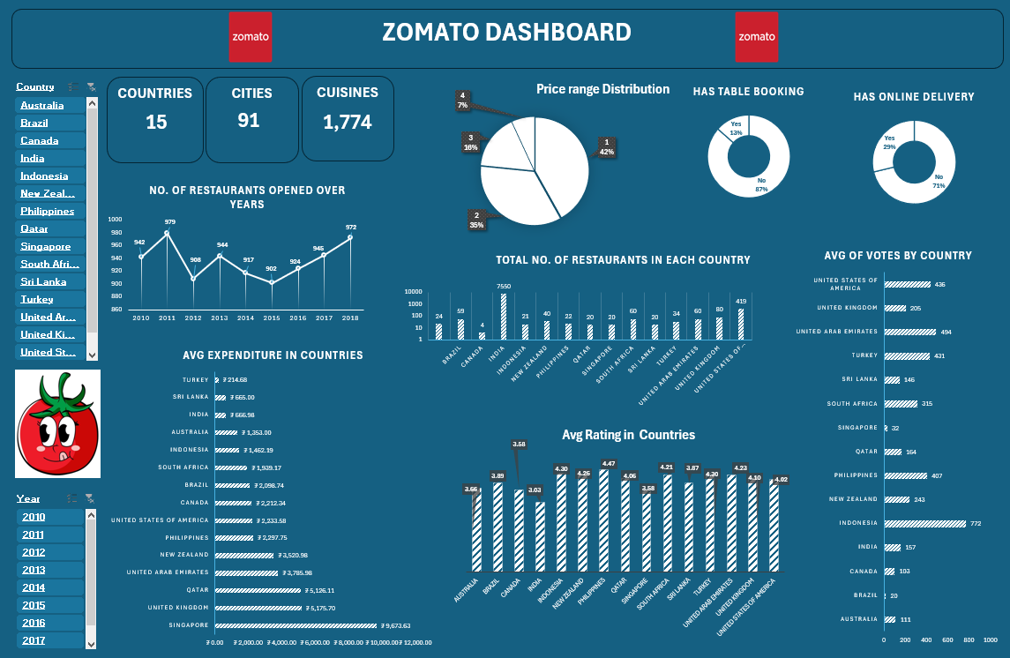
Dashboard

Slide 15
Insights
We can see the first 3 charts in our dashboard informs us about the total number of countries, cities and cuisines .
The pie charts is dynamic chart which shows us how restaurants globally are distributed among the 4 price ranges, 1,2,3 and 4. And the other 2 donut pie charts is dynamic chart which shows the percentage of restaurants having table booking and online delivery .
There are other 5 more charts which are dynamic charts which gives us the information about the number of restaurants opened over the years, total number of restaurants in each country , average votes , average expenditure in countries , and average rating in countries.
We can use the timeline slicer and country slicer to further get more targeted information.

Slide 16
Recommendations
I would recommend to open a new restaurant in countries like Canada, Qatar, Singapore or Sri Lanka.
Compared to Other Countries, the number of restaurants are less so the competition is less.
The average expenditure for two people in Sri Lanka is low if you are planning to start a new restaurant there , don’t make it too expensive.
While Singapore and Doha are expensive cities, so if you are planning to open a new restaurant there make more aesthetics and expensive to attract people.
In Canada, I would suggest Vineland Station. It is the best fit city to start a new restaurant.
And for each region plan suitable cuisines, make it more authentic and present it in a special way to attract people.
Music will be a great option to upgrade the ambience of the restaurant.

Slide 17
Conclusion
By analyzing the expenditure data, you can prioritize opening new restaurants in cities with high average costs for two people. Less saturated areas mean less competition, which translates to more customers and higher profits. This strategic approach will help manage budget constraints effectively while expanding the restaurant business.

Slide 18

THANK YOU

